Slide 1
The curious case of plant responses to carbon dioxide

Slide 2
How does CO₂ vary over space and time?

Slide 3
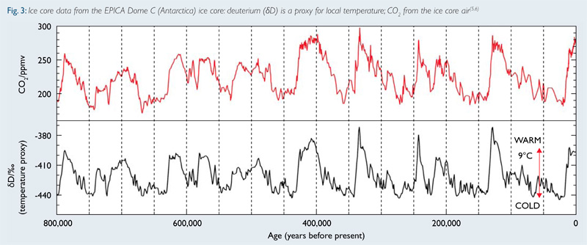
Historical rate of change: 0.002 ppm / year

Slide 4
Sidebar: Milankovitch cycles
The gravitational pull from other planets causes the tilt and orbit of the Earth to change!

Slide 5
Sidebar: Milankovitch cycles
The gravitational pull from other planets causes the tilt and orbit of the Earth to change!
When the cycle causes long Northern hemisphere summers, we are in warm period (opposite is ice age)

Slide 6
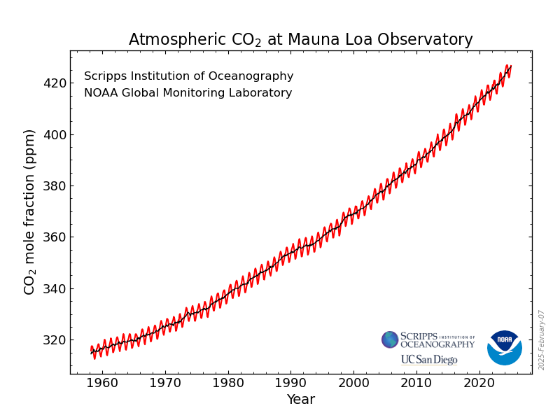
Current rate of change: 1.6 ppm / year

Slide 7
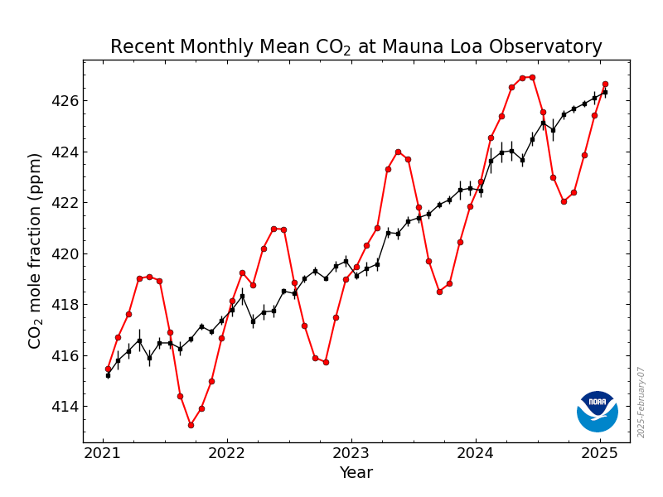
What causes the variations in the red line?

Slide 8
IPCC (2013)

Slide 9
What do you expect the plant response to be?

Slide 10
Short-term plant response to elevated CO₂: the A-Ci curve

Slide 11
Short-term plant responses to CO2: the A-Ci curve
Long et al. (2003)

Slide 12
Short-term plant responses to CO2: the A-Ci curve
CO₂
Rubisco binds CO2 to RuBP
3-C sugars created
3-C sugars prepared for export
RuBP is regenerated
Glucose et al.
Long et al. (2003)

Slide 13
Short-term plant responses to CO2: the A-Ci curve
CO₂
Rubisco binds CO2 to RuBP
3-C sugars created
3-C sugars prepared for export
RuBP is regenerated
Glucose et al.
Long et al. (2003)

Slide 14
Short-term plant responses to CO2: the A-Ci curve
CO₂
Rubisco binds CO2 to RuBP
3-C sugars created
3-C sugars prepared for export
RuBP is regenerated
Glucose et al.
Long et al. (2003)

Slide 15
Short-term plant responses to CO2: the A-Ci curve
CO₂
Hold on: What is strange about the RuBP regeneration response to CO₂?
Rubisco binds CO2 to RuBP
3-C sugars created
3-C sugars prepared for export
RuBP is regenerated
Glucose et al.
Long et al. (2003)

Slide 16
Short-term plant responses to CO2: the A-Ci curve
CO₂
Rubisco binds CO2 to RuBP
3-C sugars created
3-C sugars prepared for export
RuBP is regenerated
Glucose et al.
Long et al. (2003)

Slide 17
This response is relatively consistent across species and fairly easy to measure!

Slide 18
What do you expect the plant response to be?

Slide 19
How might the long-term response to elevated CO₂ differ?

Slide 20
How might the long-term response to elevated CO₂ differ?
Things to consider:
Each component represents a within leaf investment
Plants generally aim for efficiency
RuBP regeneration is principally determined by light availability
Rubisco is an expensive enzyme (lots of N)
It’s costly to use water

Slide 21
Free Air CO₂ enrichment (FACE) experiments

Slide 22
Ainsworth and Long (2005)

Slide 23
Ainsworth and Long (2005)

Slide 24
What does this mean for the whole plant?

Slide 25
What does this mean for the whole ecosystem?

Slide 26
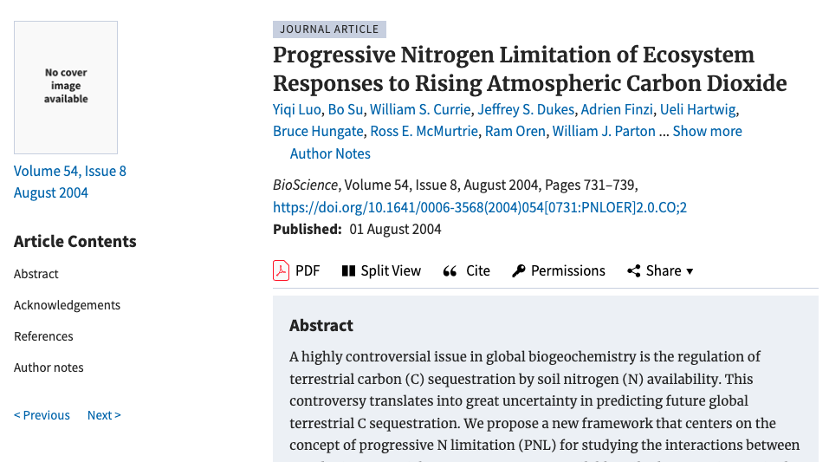

Slide 27
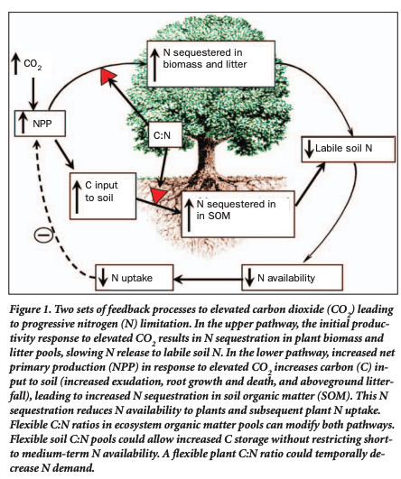
Luo et al. (2004)

Slide 28
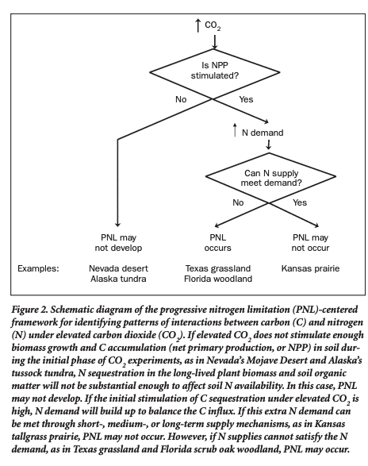
Luo et al. (2004)

Slide 29
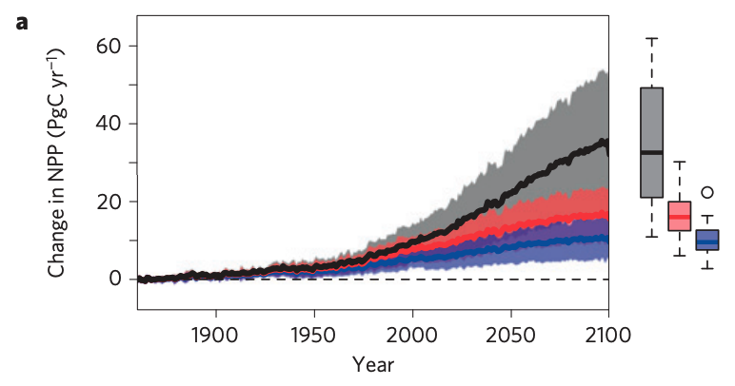
Progressive N limitation is suggested to reduce the CO₂ fertilization effect
No nutrient limitation
Nitrogen limitation
Nitrogen and phosphorus limitation

Slide 30
Is this a sign of progressive nutrient limitation or plant acclimation?
Ainsworth and Long (2005)

Slide 31
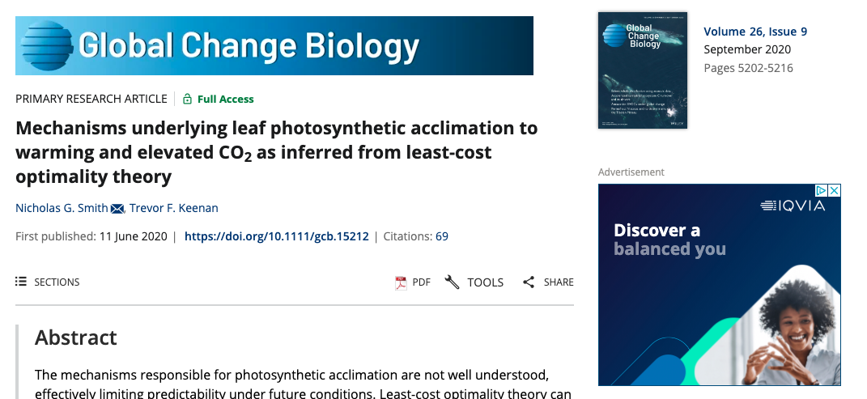

Slide 32
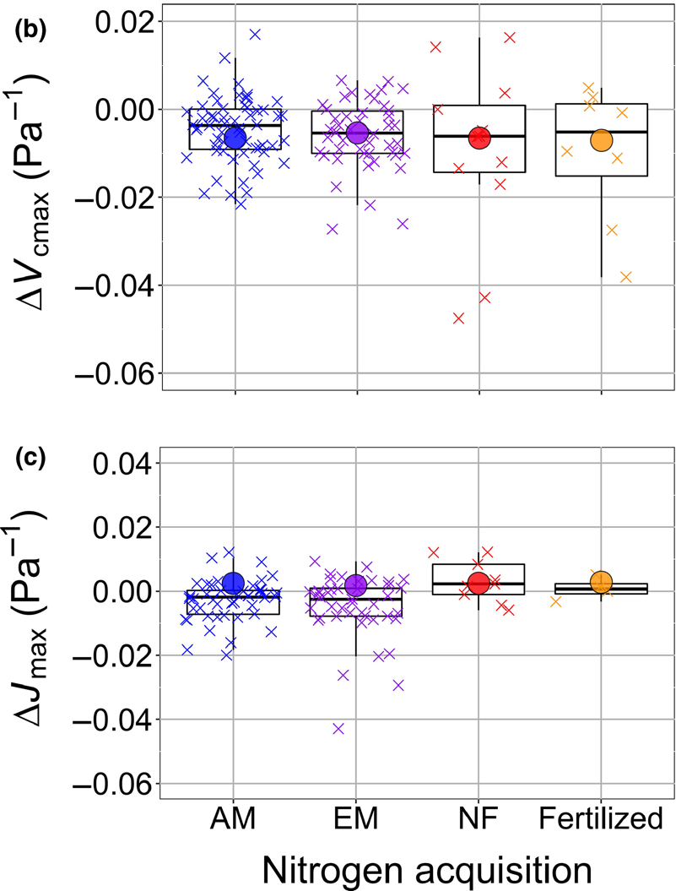
Boxes and “x”s are data from elevated CO2 experiments, showing change (∆) under elevated CO2 relative to ambient CO2. Circles are estimates based on just acclimation responses.
Takehome: acclimation-only responses match data. Therefore, PNL does not happen at the leaf level.
Smith and Keenan (2020)

Slide 34
What does this mean for models?

Slide 35
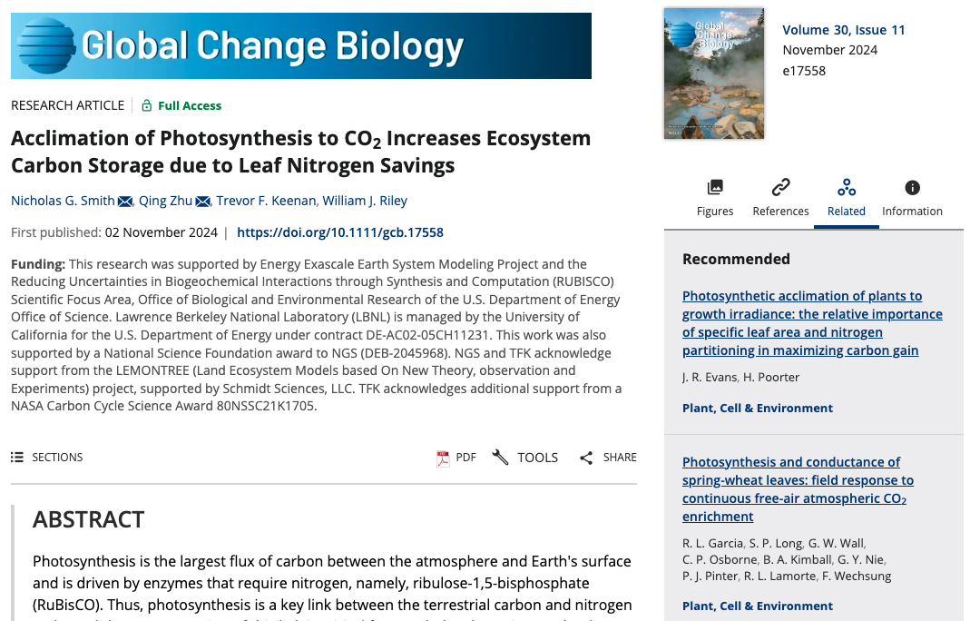

Slide 36
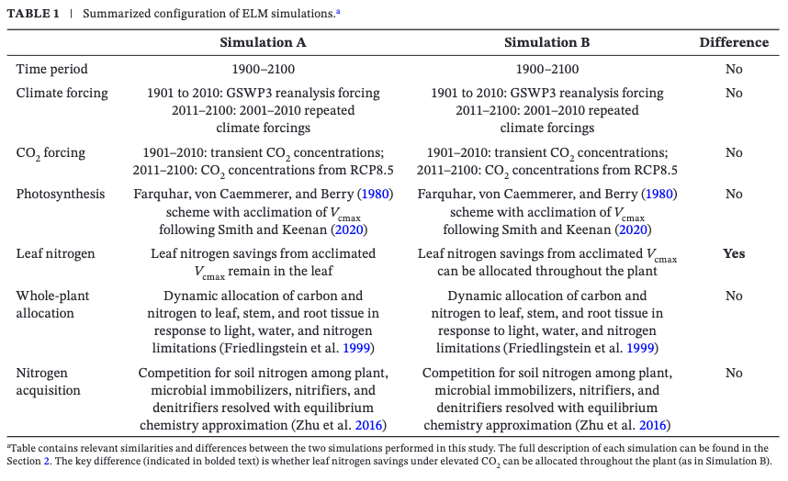
Smith et al. (2024)

Slide 37
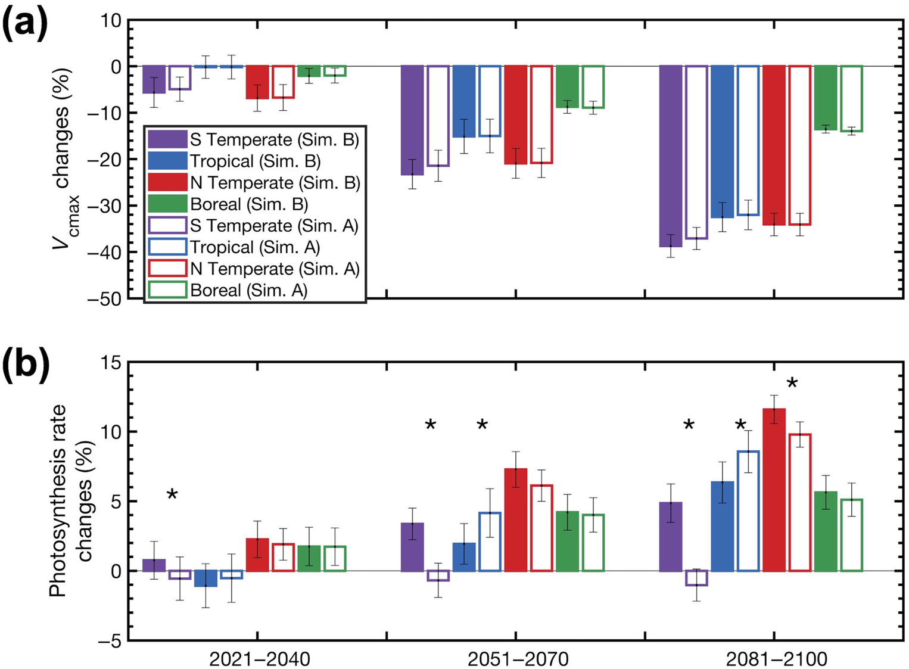
Smith et al. (2024)

Slide 38
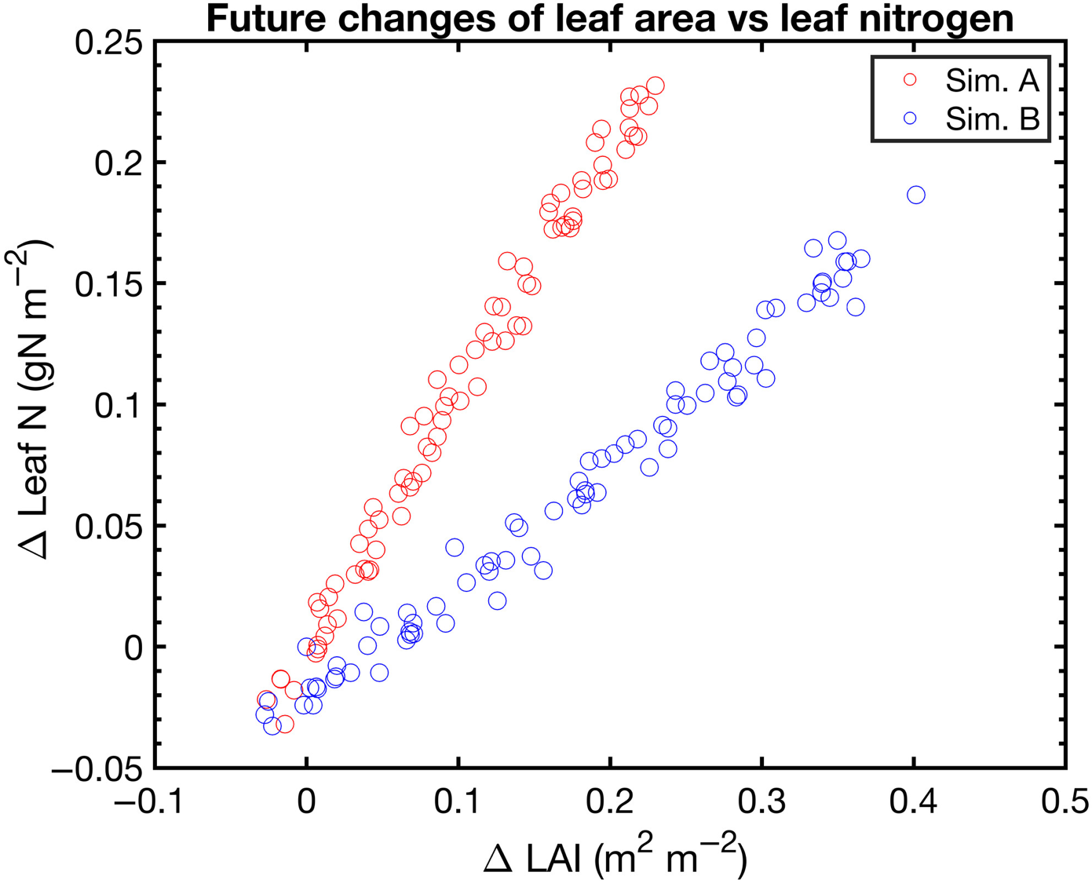
Smith et al. (2024)

Slide 39
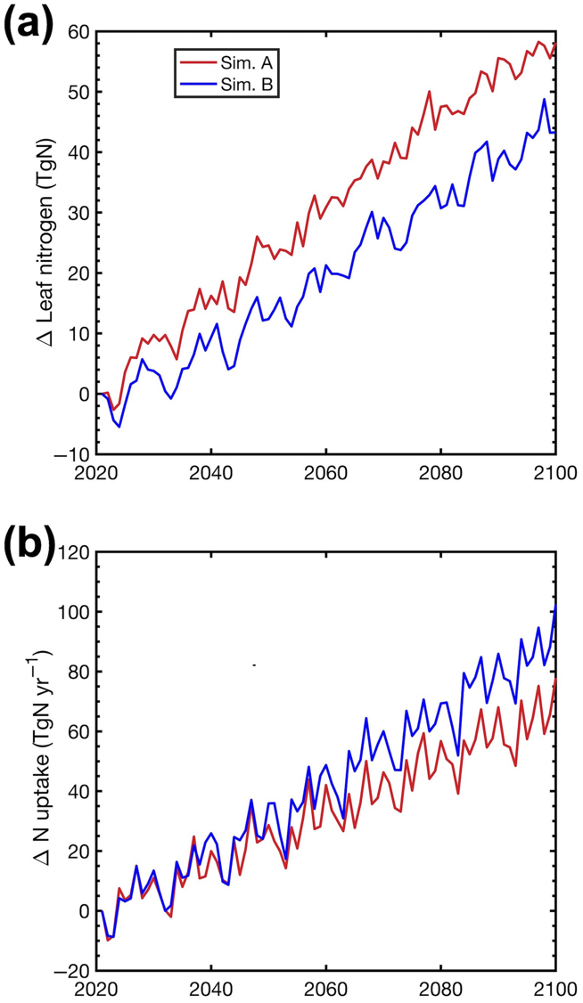
Saving leaf N, but why taking up more?
Smith et al. (2024)

Slide 40
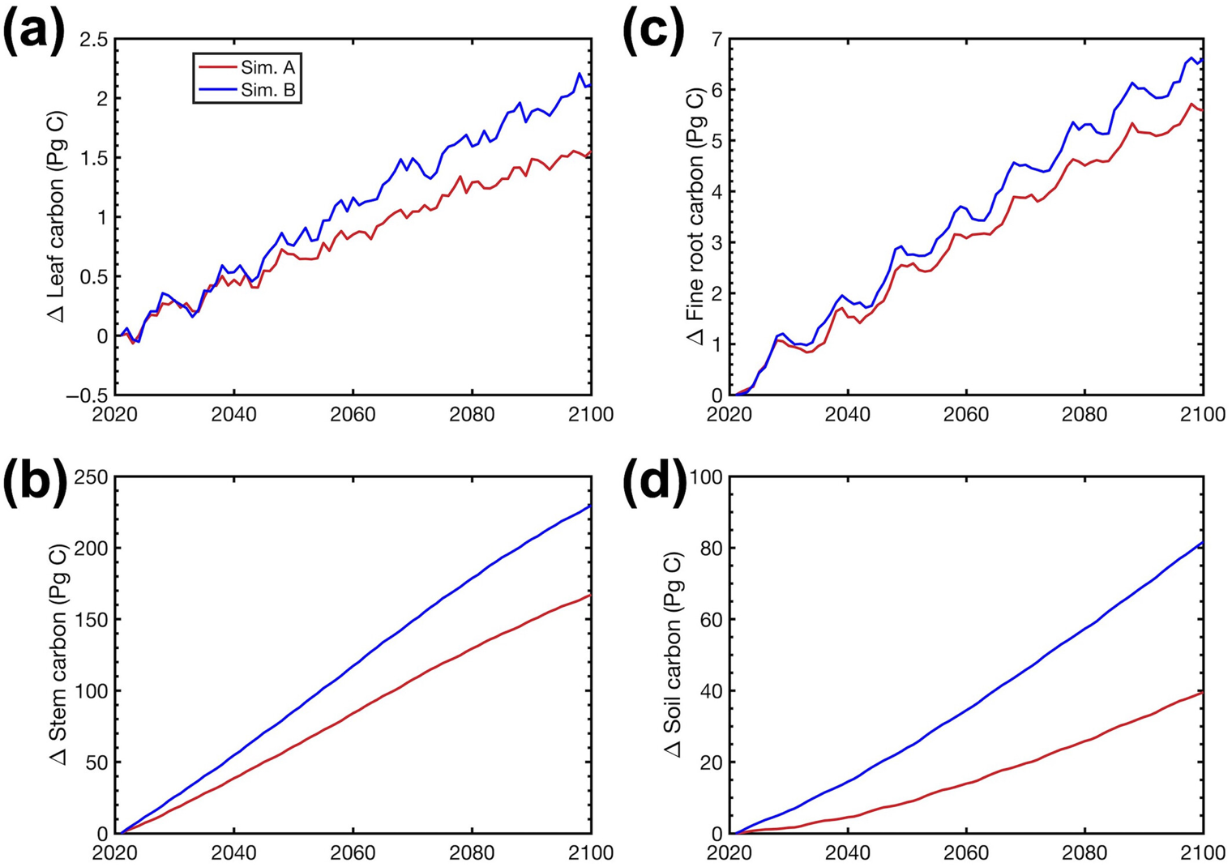
Smith et al. (2024)

Slide 41
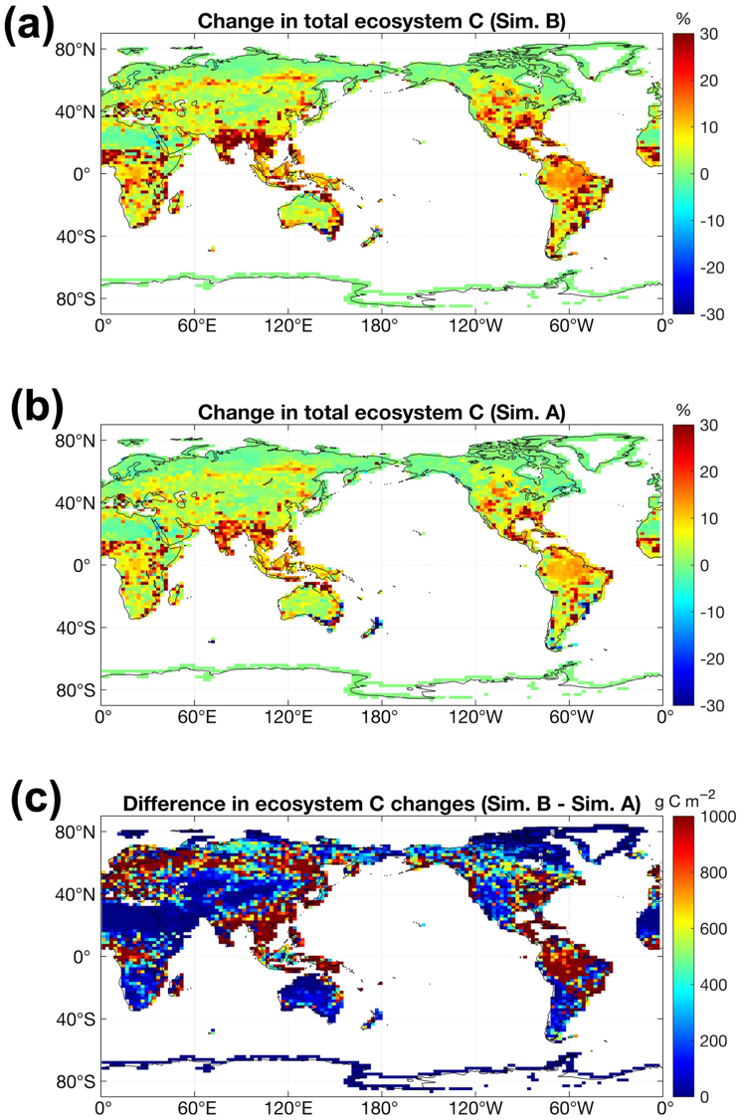
Smith et al. (2024)

Slide 42
Smith et al. (2024) takehomes
Plants acclimate to elevated CO₂ by reducing leaf nitrogen demand for Rubisco
This results in lower leaf nitrogen, but still higher photosynthesis
Plants respond by increase nitrogen allocation to roots to take up more nitrogen!
This reduces progressive nitrogen limitation

Slide 43
What do you expect the plant response to be?
Draw a systems diagram

Slide 44
Bazzaz figure for discussion

Slide 45
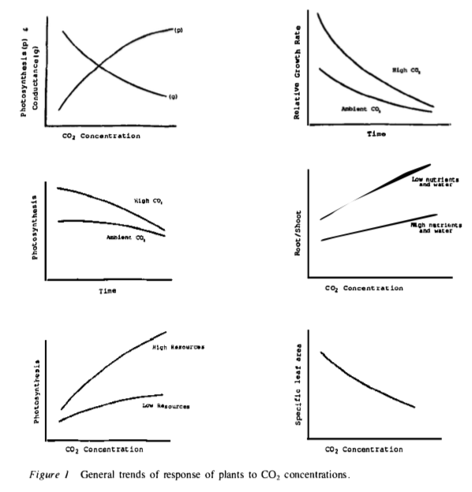
Bazzaz (1990)

